Slide 1

Sales Analysis
By David Benitoe

Slide 2
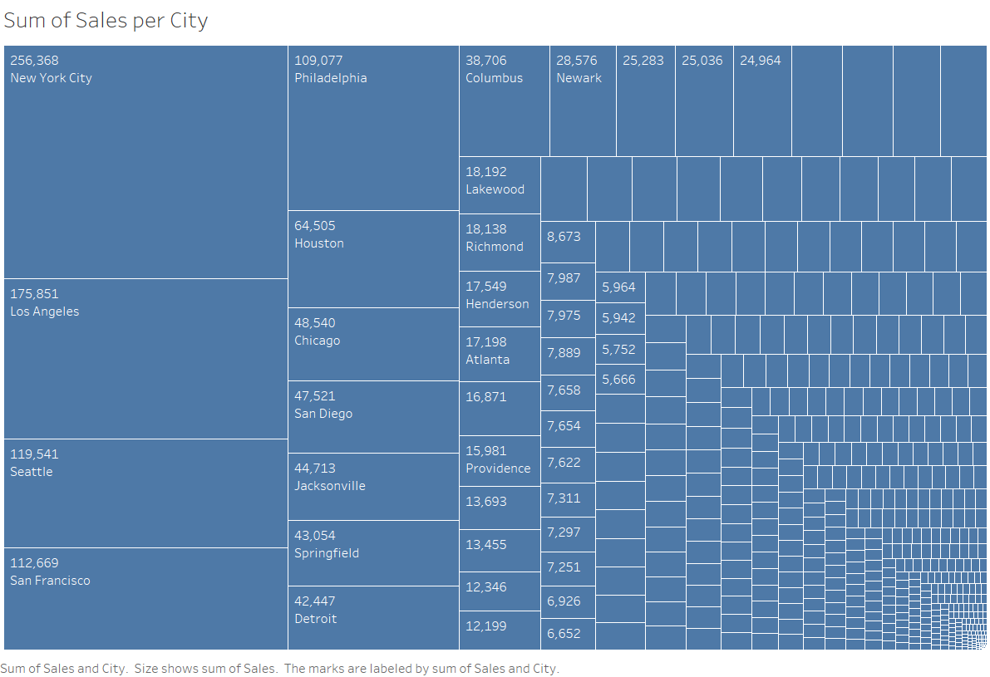
The top 5 cities with the highest sales are New York City, Los Angeles, Seattle, San Francisco, and Philadelphia. These cities exhibit significant economic activity and consumer demand, driving substantial revenue for the company. Their collective sales contribute a considerable portion to the overall revenue generated.

Slide 3
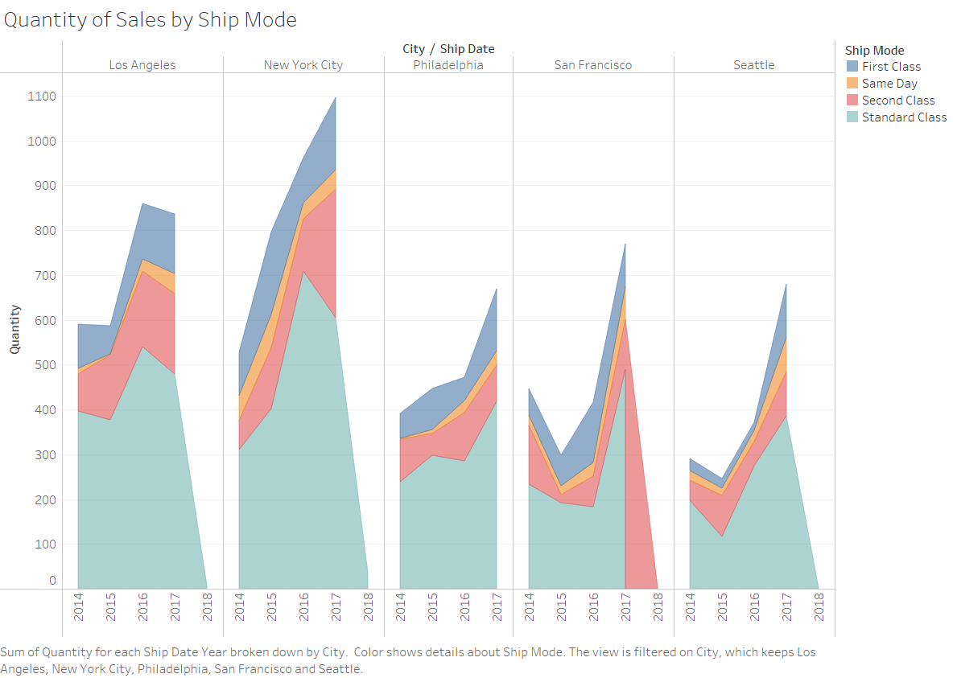

Slide 4

Relationship between Ship Mode and Top 5 Cities by Sales:
When analyzing the quantity of sales by ship mode in the top 5 cities by sales, we can observe the following trends:
First Class Shipments:
In all the top 5 cities, the quantity of first-class shipments has shown a consistent upward trend.
These cities prioritize expedited delivery due to their high population density and demand for swift order fulfillment.
Same Day Shipments:
While Same Day shipments are relatively lower in quantity compared to other ship modes, they have witnessed growth in all top 5 cities.
Urban areas like New York City, Los Angeles, and San Francisco likely contribute to the demand for immediate deliveries.
Second Class Shipments:
The quantity of second-class shipments varies among the top 5 cities.
San Francisco and Seattle show a consistent growth trend, indicating the preference for a balance between cost and delivery time.
Standard Class Shipments:
Standard Class shipments exhibit the highest quantities across all ship modes and cities.
This model is famous for its cost-effectiveness and is extensively used in cities with high sales volume, such as New York City and Los Angeles.
It's worth noting that each city's unique characteristics, consumer preferences, and economic activities contribute to the varying quantities of shipments by ship mode. These insights can help tailor shipping strategies to serve the demands of each city best and optimize customer satisfaction.

Slide 5
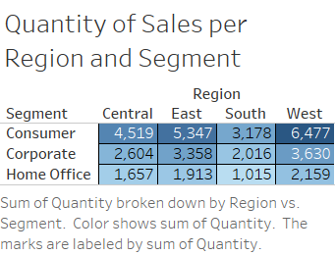

Slide 6

Segment Analysis: Sales Variance among Regions
Analyzing the differences in sales between each segment across regions provides valuable insights into consumer behavior and market trends. Let's dive into the sales variances among regions and segments:

Slide 7

Central Region:
Consumers in the Central region exhibit a strong preference for purchases, contributing significantly to the total sales.
Corporate and Home Office segments follow with slightly lower sales quantities.
This indicates a consumer-driven market in the Central region.
East Region:
In the East region, the Consumer segment generates the highest sales, indicating strong consumer demand.
The Corporate segment follows with substantial sales, while the Home Office segment contributes less.
The East region's focus on consumer and corporate sales suggests a robust economic landscape.

Slide 8

South Region:
Like the East, the Consumer segment leads in sales in the South region, highlighting consumer-oriented markets.
The Corporate segment follows, though with a notable gap from the Consumer segment.
Home Office sales are lower compared to the other segments.
West Region:
The West region stands out with balanced sales across all segments: Consumer, Corporate, and Home Office.
This diversity suggests a well-rounded market with active participation from different customer types.

Slide 9

Summary
By synthesizing these takeaways, businesses comprehensively understand their sales landscape. Recognizing segment-driven sales trends, adapting shipping strategies to city preferences, and tailoring marketing approaches can lead to effective revenue generation and customer satisfaction. Understanding the interplay between region, segment, ship mode, and city characteristics is crucial for optimizing operations and driving success in a dynamic market environment.

